Slide 1
Parallel Sigma Point Trajectory Propagation with Kokkos
Scott Blender

Slide 2
background
Nonlinear dynamical systems necessitate advanced numerical computing techniques for forecasting their behavior over time.
In systems that account for uncertainty, the Unscented Kalman Filter (UKF) offers a method for state estimation in nonlinear control. It does this by using a deterministic process to approximate a Gaussian distribution.
A set of 2n + 1 sigma points is utilized to approximate the Gaussian distribution of points, with scaling parameters alpha, beta, and lambda determining the spread of these points.

Slide 3
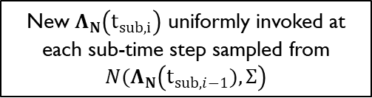


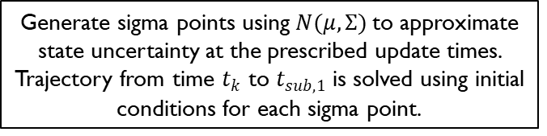



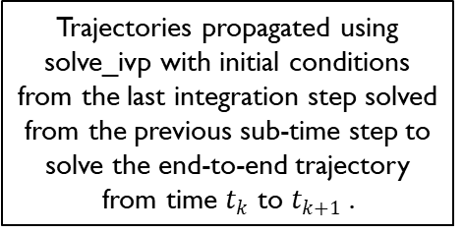
Trajectories propagated using solve_ivp with initial conditions from the last integration step solved from the previous sub-time step to solve the end-to-end trajectory from time $t_{k}$ to $t_{k+1}$.
Generate sigma points using$N(μ,Σ)$to approximate state uncertainty at the prescribed update times. Trajectory from time $t_{k}$ to $t_{sub, 1}$ is solved using initial conditions for each sigma point.
time: $t_{k}$
time: $t_{k+1}$
$$t_{sub,1}$$
…
$$t_{sub, i}$$
…
$$t_{sub, n}$$
New $Λ_{N}\left(t_{sub, i}\right)$ uniformly invoked at each sub-time step sampled from $N(Λ_{N}\left(t_{sub, i−1}),Σ\right)$

Slide 4
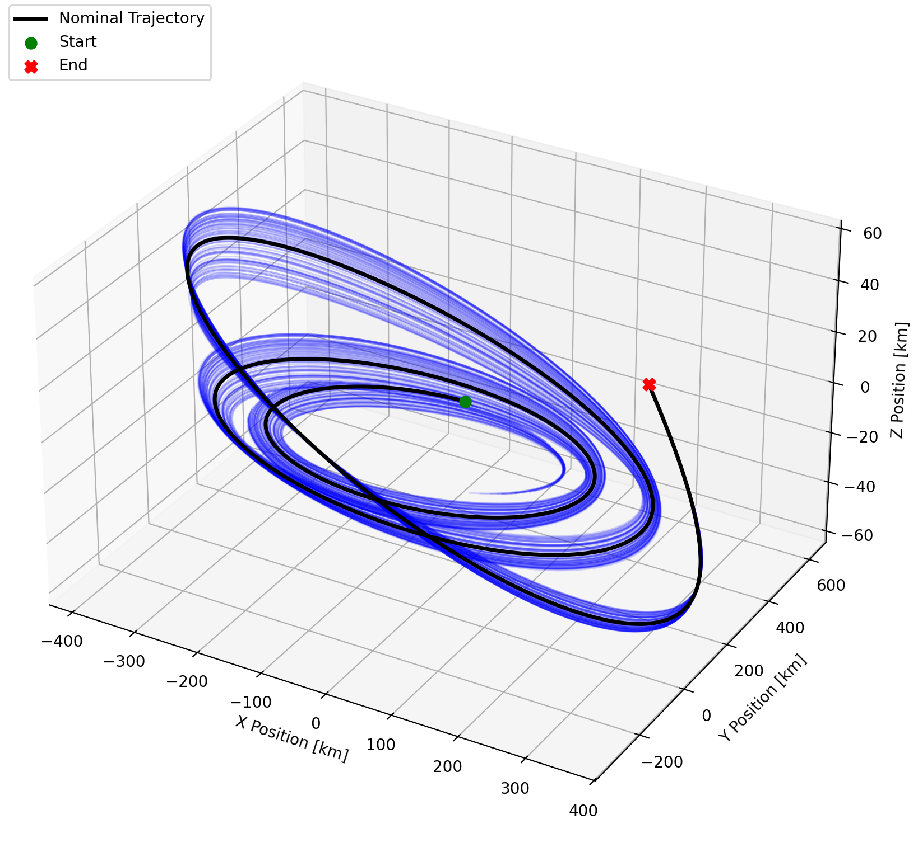
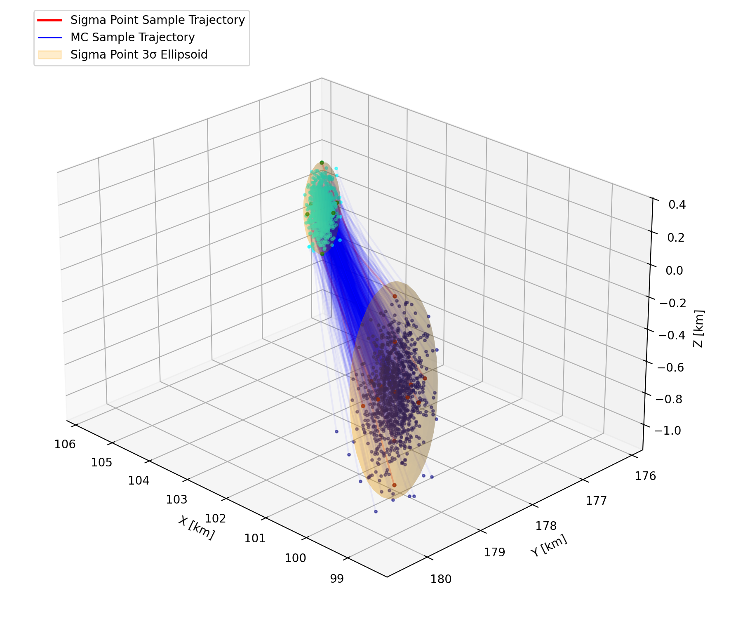

Slide 5
Motivation
The propagation of complex nonlinear systems requires accurate and efficient methods to determine solutions
Integration using built-in python modules like solve_ivp are slow and resource inefficient
Parallelization on SERIAL, OPENMP, and CUDA backends provide resource efficient methods to shorten computational cost using Kokkos
Currently, there are multiple ways the workflow can be parallelized
Sigma Point trajectories are independent from each other.
The original mesh generates discretized time steps, with each being independent of the others.
Bundles function independently of each other.
Kokkos::MDRangePolicy<ExecSpace, Kokkos::Rank<3>>({0, 0, 0}, {num_bundles, num_sigma, num_steps - 1})

Slide 6
Code workflow
CMakeLists.txt - Compiles code, creates libraries for trajectory propagation, and exports executables to build/
install.sh - Allows user to run
./install.sh RunWithDebInfo SERIAL, OPENMP, or CUDA depending on backend
install.sh
CMakeLists.txt
cmake-tests.yaml - Used for GitHub actions to expedite debugging, code compilation, and unit testing
cmake-tests.yaml
CPU - Port python code into .cpp format, designed for SERIAL (explicit loops and host-only calculations)
GPU - Use Kokkos to share data between host and device (DeepCopy/Mirror/cudaMemcypy) and ParallelFor
CPU
GPU
Code Folders - include/ holds .hpp files and classes, src/ holds .cpp files, and testing/ holds Catch2 unit tests
include/
src/
tests/
Folder Layout - Standard C++ folder layout. CMakeLists.txt also generates a build/ in each directory

Slide 7
Unit Testing
Python
Python – Original script written in Python used to generate three csv file: initial_bundles_all.csv, expected_trajectories_bundle_32.csv, sigma_weights.csv.
Catch2 – Used for all unit testing, specifically Matchers (WithinAbs)
CPU
GPU
Test Sigma Points – Unit test to check that sigma point generate (using initial_bundles_all.csv and sigma_weights.csv) is generating sigma points appropriately
test_sigma_points.cpp
test_sigma_propagation.cpp
test_sigma_propagation_cpu.cpp
Test Sigma Propagation – Unit test to ensure the CSV reading of expected_trajectories_bundle_32.csv is correct.
Test Sigma Propagation CPU – Unit test to check that results from Python for Trajectory 32 from the bundle for serial code
test_sigma_propagation_gpu.cpp
Test Sigma Propagation GPU – Unit test to check that results from Python for Trajectory 32 from the bundle for cuda-compliant/GPU code

Slide 8
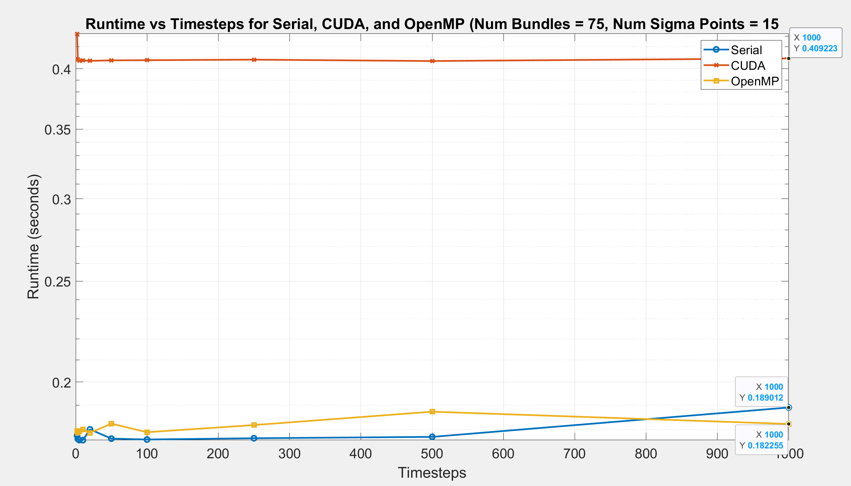

Slide 9
remarks
The problem size is too small to benefit from GPU processing.
The overhead associated with parallel processing (such as GPU kernel launches and host-to-device data transfers) outweighs the advantages of serial evaluation.
There is excessive data transfer between the host and the device.
Thread divergence may occur when propagating trajectories.
The RK45 solver could introduce complications.
Using CPU and OpenMP is more effective for propagating complex systems that require complex or adaptive numerical integration with conditional logic.

Slide 10
Future work
Increase the number of bundles and time steps to reduce the overhead cost of GPU usage.
Minimize host-to-device transfer operations.
Implement random control sampling that works on the device.
Modify the RK45 integration routine to be device-compatible.
Further integrate parallelization routines in the code.
Apply hierarchical parallelism using team policies.
Utilize shared scratch memory for RK45 integration to enhance cache reuse and scalability for CUDA.

Slide 11
Live demo using Aimos (DCS)

Slide 12
references
Wan, E. A., & van der Merwe, R. (2000). The unscented Kalman filter for nonlinear estimation. Proceedings of the IEEE 2000 Adaptive Systems for Signal Processing, Communications, and Control Symposium, 153–158. IEEE.
Singh, S. K., & Junkins, J. L. (2022). Stochastic learning and extremal-field map based autonomous guidance of low-thrust spacecraft. Scientific Reports, 12, 17774. https://doi.org/10.1038/s41598-022-22730-y
Psiaki, M. L. (2009). The blind tricyclist problem and a comparative study of nonlinear filtering for low-cost INS/GPS navigation. IEEE Transactions on Aerospace and Electronic Systems, 45(2), 525–546. https://doi.org/10.1109/TAES.2009.5089493
Daniel, D. (2024, April 26). The Kokkos lectures: Advanced reductions and scans [Presentation slides]. National Energy Research Scientific Computing Center (NERSC). https://www.nersc.gov/assets/Uploads/Kokkos-training-Day1-AdvancedUsers-Daniel.pdf

